Slide 1




Background Subtraction Using Local SVD Binary Pattern
B.S.C.S. Franci Suni Lopez
B.S.C.S. Joel Gallegos Guillen

Slide 2
Approach
Strong method for changes of ilumination.

Slide 3
Code
Source code on Python
python localsvd2016 -g highway/groundtruth -f highway/input -k 1700

Slide 4
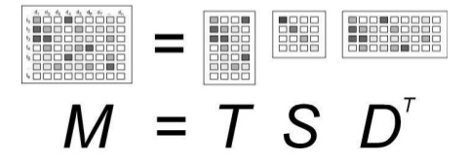
Singular-value Decomposition (SVD)
SVD is utilized in noise filtering.
The largest object components in an image found using the SVD generally correspond to eigenimages associated with the largest singular values, while image noise corresponds to eigenimages associated with the SVs
*SVD Based Image Processing Applications: State of The Art, Contributions and Research Challenges, 2012

Slide 5
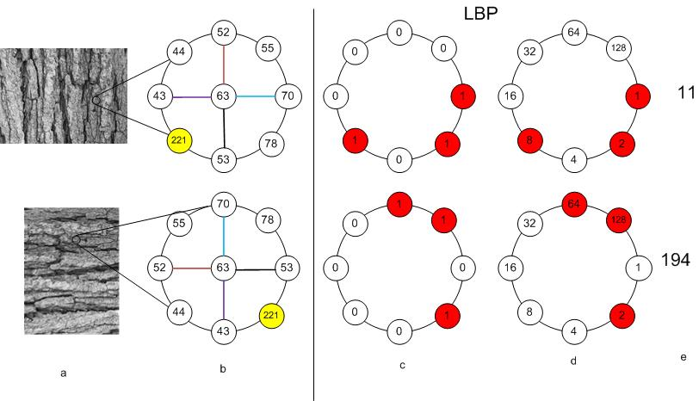
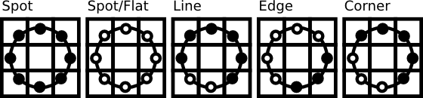
Local Binary Pattern (LBP)
Very efficient texture operator
The Local Binary Pattern Approach and its Applications to Face Analysis (2008)
Chapter 2: Local Binary Patterns for Still Images
Face Recognition with OpenCV (https://docs.opencv.org/2.4/modules/contrib/doc/facerec/facerec_tutorial.html)

Slide 6
Core
For each pixel of the N frames Extract the LSBP (Local SVD Binary Pattern ) descriptor
Local Binary Pattern (LBP)
Singular Value Decomposition (SVD)

Slide 7
Core
Compare in each pixel LSBP descriptor and color.
LSBP: XOR
Color: L1-> |r-r1|+|g-g1|+|b-b1|

Slide 8
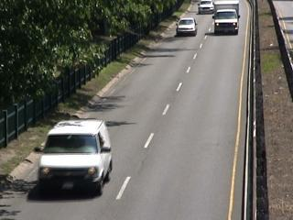
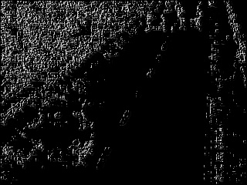
LSBP

Slide 9
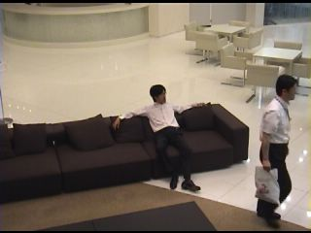

Problems with color distance
?
Paper results.
L1 distance is basic.

Slide 10
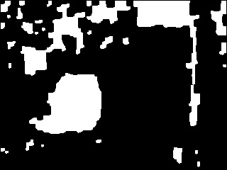


Color Threshold
Low threshold
(12)
Smart threshold
(120)
High threshold
(200)

Slide 11
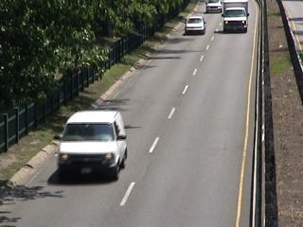
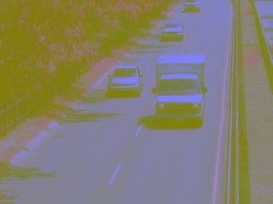
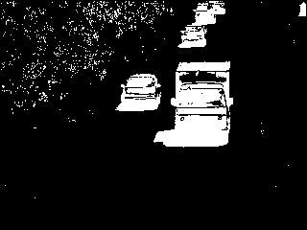


Our improvements
Erode and dilate
Original frame
LAB: Better difference of colors.
Result of color and LSBP difference.
Fill contours

Slide 12
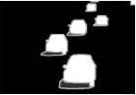
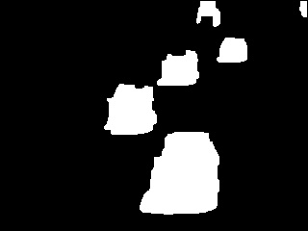


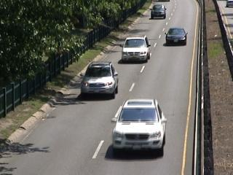
Highway dataset
Groundtruth
Paper
Source code
4.19 seg
Our implementation
169 ms

Slide 13






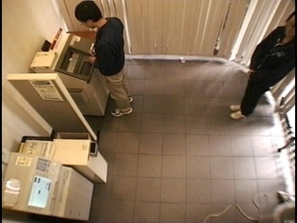
CopyMachine dataset
Groundtruth
Paper
Source code
5.12 seg
Our implementation
169 ms

Slide 14
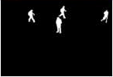
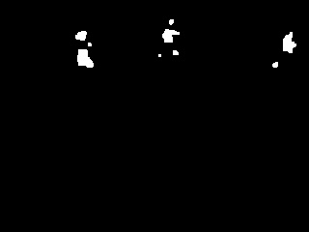

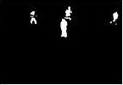
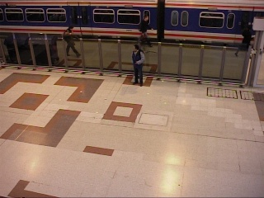
PETS2006 dataset
Groundtruth
Paper
Source code
5.28 seg
Our implementation
169 ms

Slide 15
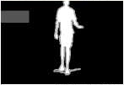
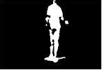
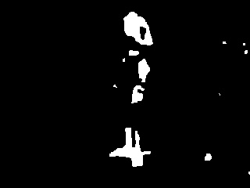

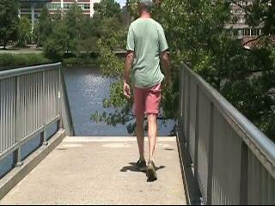
Overpass dataset
Groundtruth
Paper
Source code
4.97 seg
Our implementation
169 ms

Slide 16
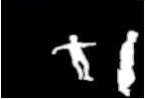
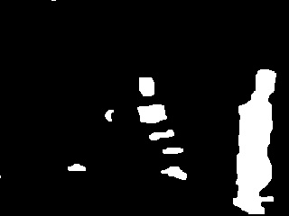
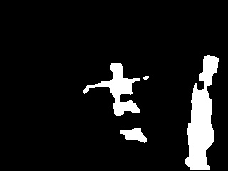
Sofa dataset
Groundtruth
Paper
Source code
4.49 seg
Our implementation
171 ms

Slide 17

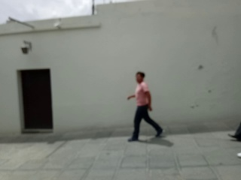

Street-people dataset
Source code
5.19 seg
Our implementation
165 ms

Slide 18

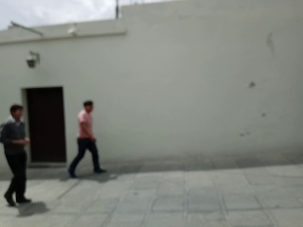

Street-people dataset
Source code
5.19 seg
Our implementation
165 ms

Slide 19

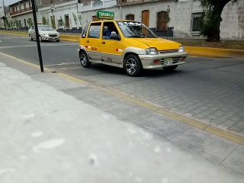
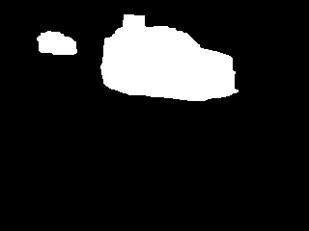
Street-cars dataset
Source code
6.23 seg
Our implementation
157 ms

Slide 20

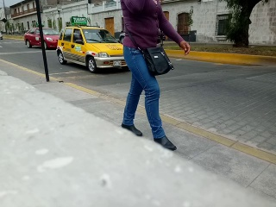

Street-cars dataset
Source code
6.23 seg
Our implementation
157 ms

Slide 21
Thanks!
Questions?

